Slide 1
Debrief 11/04/23

Slide 2



Week 5: Corporate Project & Start of Mentorship
 | Monday 10 April | Tuesday 11 April | Wednesday 12 April | Thursday 13 April | Friday 14 April
10.00am to 12.30pm | Corporate Project Meeting Project Sponsors 2 | Corporate Project | Job Readiness Workshop Mentorship Session 1 | Job Readiness Communications Workshop | Digital Skills Learning
12.30pm to 2pm | Lunch Break | Lunch Break | Lunch Break | Lunch Break | Lunch Break
2pm to 4.30pm | Corporate Project | Corporate Project | Job Readiness Workshop Corporate Profile Shot | Job Readiness Communications Workshop | Digital Skills Learning
In-person session at
Republic Polytechnic
Work From Home (WFH)
Flexible arrangement
Company Visit

Slide 3
Programme for 12th April 2023 (Wednesday)
Time | Event | Venue
9.50am | Report to Republic Poly
10am -12.30pm | 11am: Mentorship Session 1 | Library
12.30pm – 2pm | Lunch
2pm - 4pm | Profile Shot + Team Shot (Those waiting for their turn, work on your CV) | North Canteen
4.15pm – 4.30pm | Debrief
4.30pm | Dismissal
Things to Bring: Laptop with Charger, ear-piece, money for lunch, comb, make-up writing materials and handphone. Own Make-up brushers (Optional)
Wear: Business Casual

Slide 4


Minimum Attire for Photoshoot

Slide 5
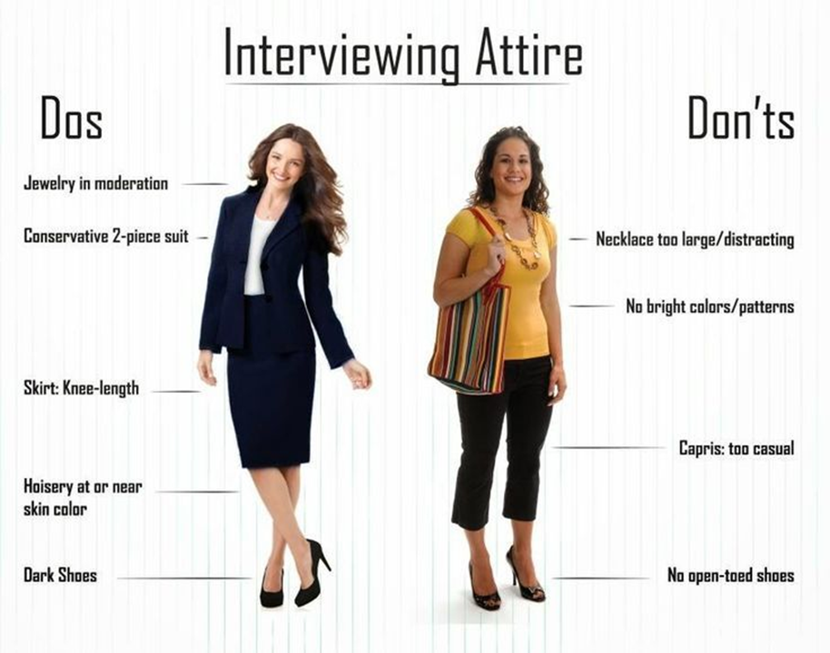
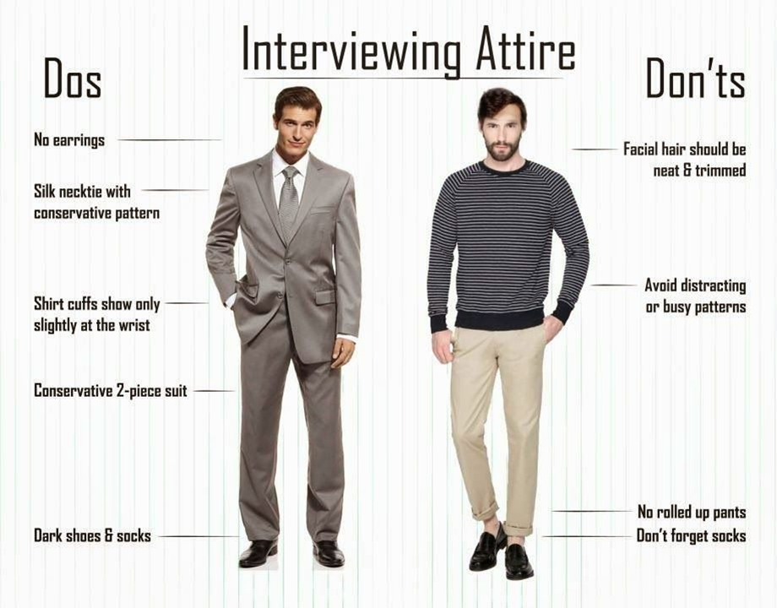
Ideal Attire for Photoshoot

